Slide 1
ESP32
Modules
Complementary
Filter
Balance
Controller
WIFI
Communication
output
Controller
& Webserver
Stepper
Motor
Web
Server

Slide 2
FreeRTOS Architecture with MQTT
ESP32
FreeRTOS
Tasks
MQTT Topics
publish
roverStateLoop
Core 0
deadreckoning_data
red_beacon
Task Scheduluer
blue_beacon
keepMQTTAlive
yellow_beacon
Core 1
subscribe
localise
controlLoop
rover_current_coords

Slide 3
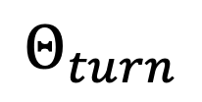
$$Θ_{turn}$$
Rover equipped with compass

